Slide 1
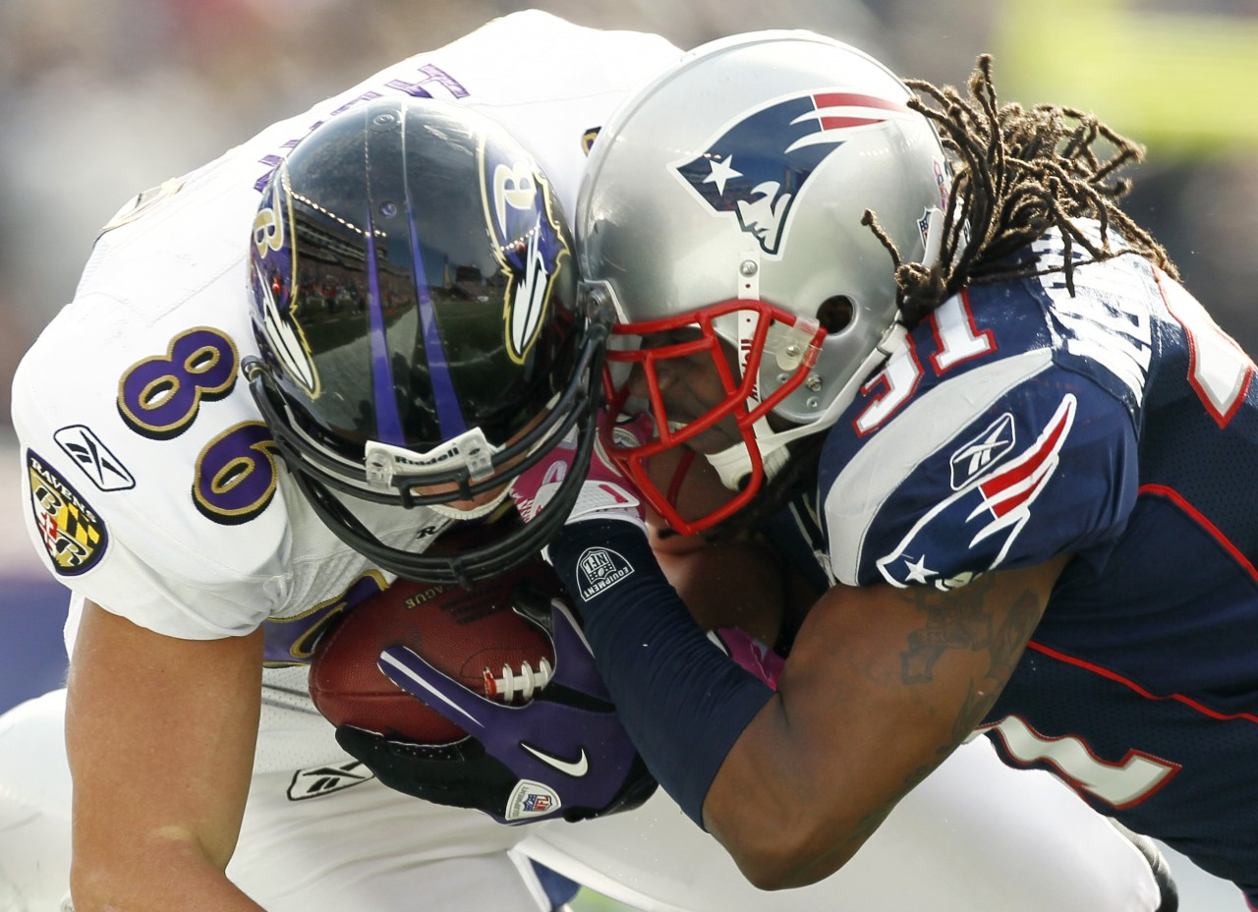
THE EFFECTS OF PREVIOUS CONCUSSIONS ON THE PHYSIOLOGICAL COMPLEXITY OF MOTOR OUTPUT DURING A CONTINUOUS ISOMETRIC VISUAL-MOTOR TRACKING TASK
Adam Raikes, MS, LAT, ATC

Slide 2
Checklist for me before presentation
Finish slides
Bring dry erase marker
Bring money for bribes

Slide 3
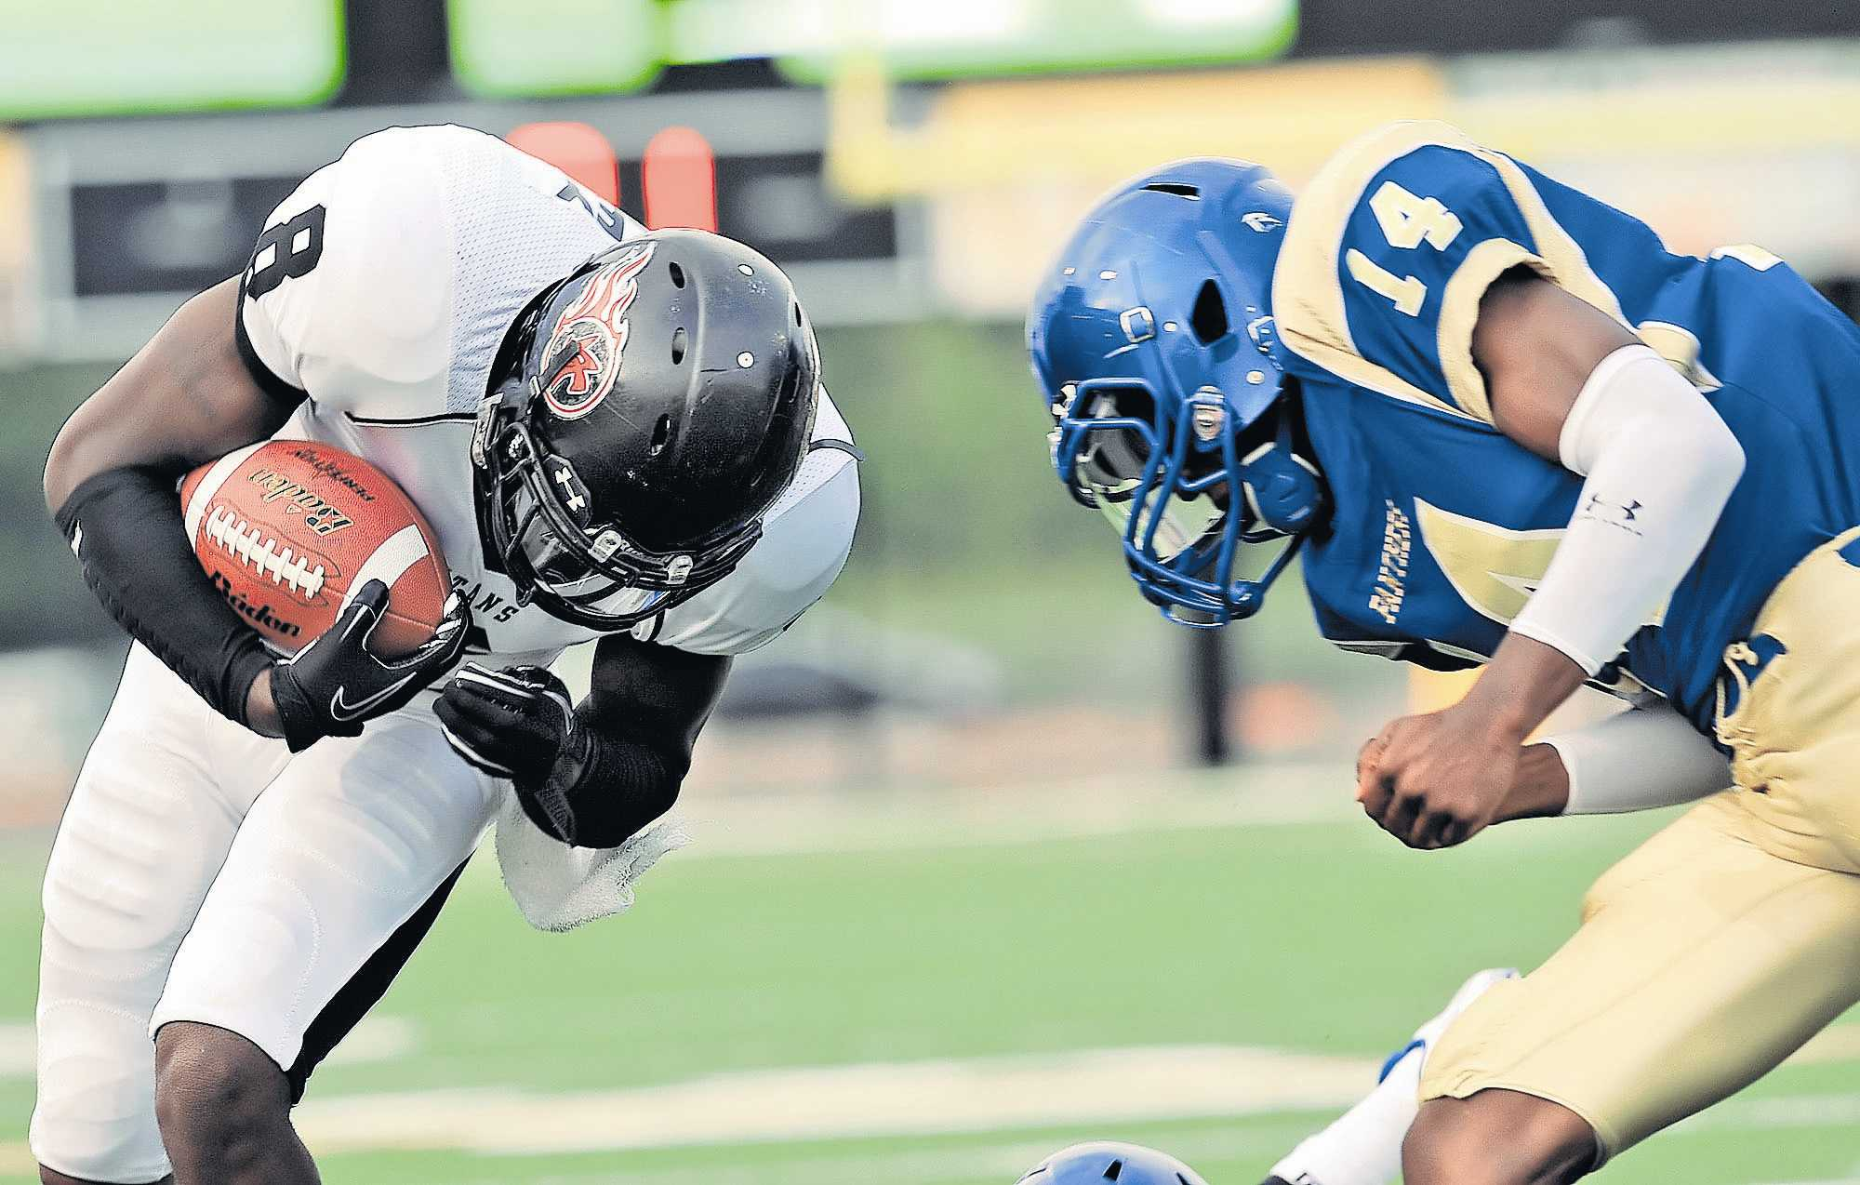
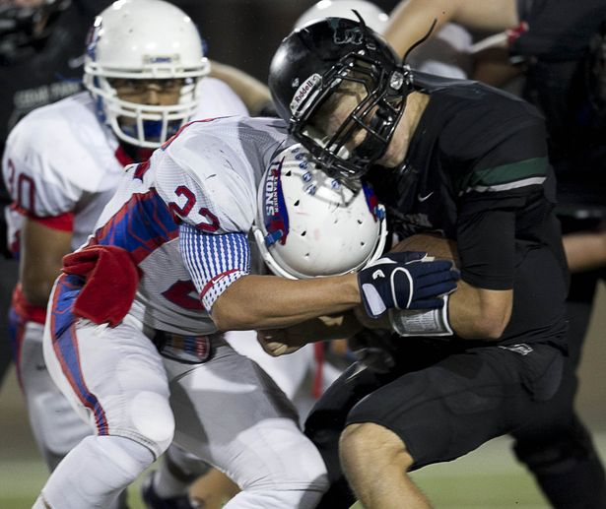
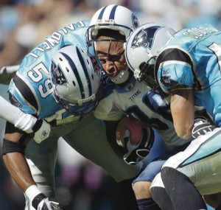
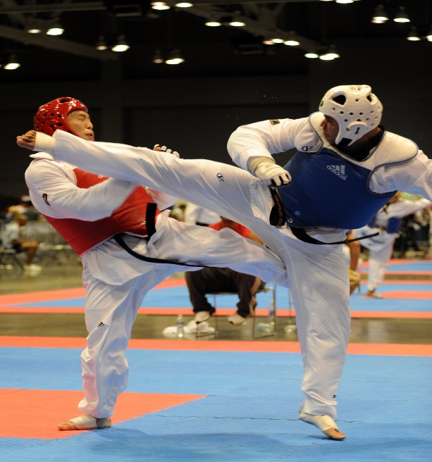


Notes:
Concussions are brain injuries caused by a blow to the head or body. An estimated 1.6-3.7 million concussions occur each year, that we are aware of. Furthermore, recent high profile suicides by former NFL players linked to repetitive concussions as well as the myriad of health issues resulting from blast-induced head injuries for servicemen and women have brought concussion management issues to the forefront of social and scientific inquiry.

Slide 4
ER: $500
MRI: $900
CT: $460
PET: $2475
PS: $1150
Indirect costs
Agency for Healthcare Research and Quality
http://www.newchoicehealth.com/Directory
Notes:
High cost associated with managing concussions. Estimated costs are $22 bn annually and this is very likely an underestimation d/t nonreporting. Part of the direct costs are associated with the potential for catastrophic concomitant injuries and the “necessity” to rule them out. Additionally, there are indirect costs (job, sport, academic time loss, interpersonal relationships, etc) as a result of the symptoms ->

Slide 5
Memory Attention Executive Function Reaction Time Verbal Processing Visual Processing Affective and behavioral
Insomnia or hypersomnia
Trouble staying asleep
Poor sleep quality
Posture Gait Dexterity Motor Control
Notes:
.. And symptoms (manifesting as impairments or alterations) exist over multiple domains and each one may present across a spectrum of severity. While we highlight here the cognitive, motor, and sleep related issues, we must also acknowledge that there are behavioral changes and somatic symptoms as well. We do have methods for quantifying and identifying these …

Slide 6
SAC/SCAT3
Computerized neurocognitive testing
Functional neuroimaging
Polysomnography
Actigraphy
BESS
Instrumented postural stability testing
Gait analysis
Notes:
There are some clinical metrics with demonstrated validity, reliability, sensitivity, and specificity. However, numerous neuroimaging and instrumented studies have shown that these clinical tools may under-identify deficits and that deficits may persist long after the accepted clinically manifested course. This is problematic because return to play/learn/activity/work/life decisions are often guided both by clinical judgment and these tools. Further..

Slide 7
Mild cognitive impairment
Alzheimer’s Disease
CTE
Chronic insomnia
Sleep/wake disorders
Parkinson’s Disease
Amyotrophic Lateral Sclerosis
CTE
Notes:
There are multiple neurological and neurodegenerative diseases and disorders that have been linked to concussion history in all of these domains. While not everyone who has 1+ concussions will get one of these, the risk exists and we do not know how great the risk is or what factors go in to ultimately developing 1 or more of these. However, all of these conditions….

Slide 8
Mild cognitive impairment
Alzheimer’s Disease
CTE
Chronic insomnia
Sleep/wake disorders
Parkinson’s Disease
Amyotrophic Lateral Sclerosis
CTE
Poorer quality of life
High lifetime medical costs
Notes:
have those. So the challenge right now is to identify ways to identify extant deficits within a clinical framework to provide best care for athletes and humanity.

Slide 9
Clinical
Time
Research
Time
Facilities
Cost
Facilities
Education
Compliance
Appropriate staffing
Appropriate staffing
Access to patient population
Cost
Notes:
And the challenge is two-fold. While staffing can be managed, what we really need to address right now are the issues related to time, cost, and facilities for testing. As we saw, the neuroimaging methods are costly and require a dedicated space and staff. Box has animation. And so, what we want to talk about today is how we may be able to aid the clinical decision-making process and make some inferences about neurological subsystems within a nonlinear dynamical framework.

Slide 10
Nonlinear Dynamics
Notes:
Nonlinear dynamics deal with temporal, spatial, and frequency-domain characteristics of things measured over time. While we apply them to physiological signals, they can and have been applied to many domains where measurements are made over time.

Slide 11
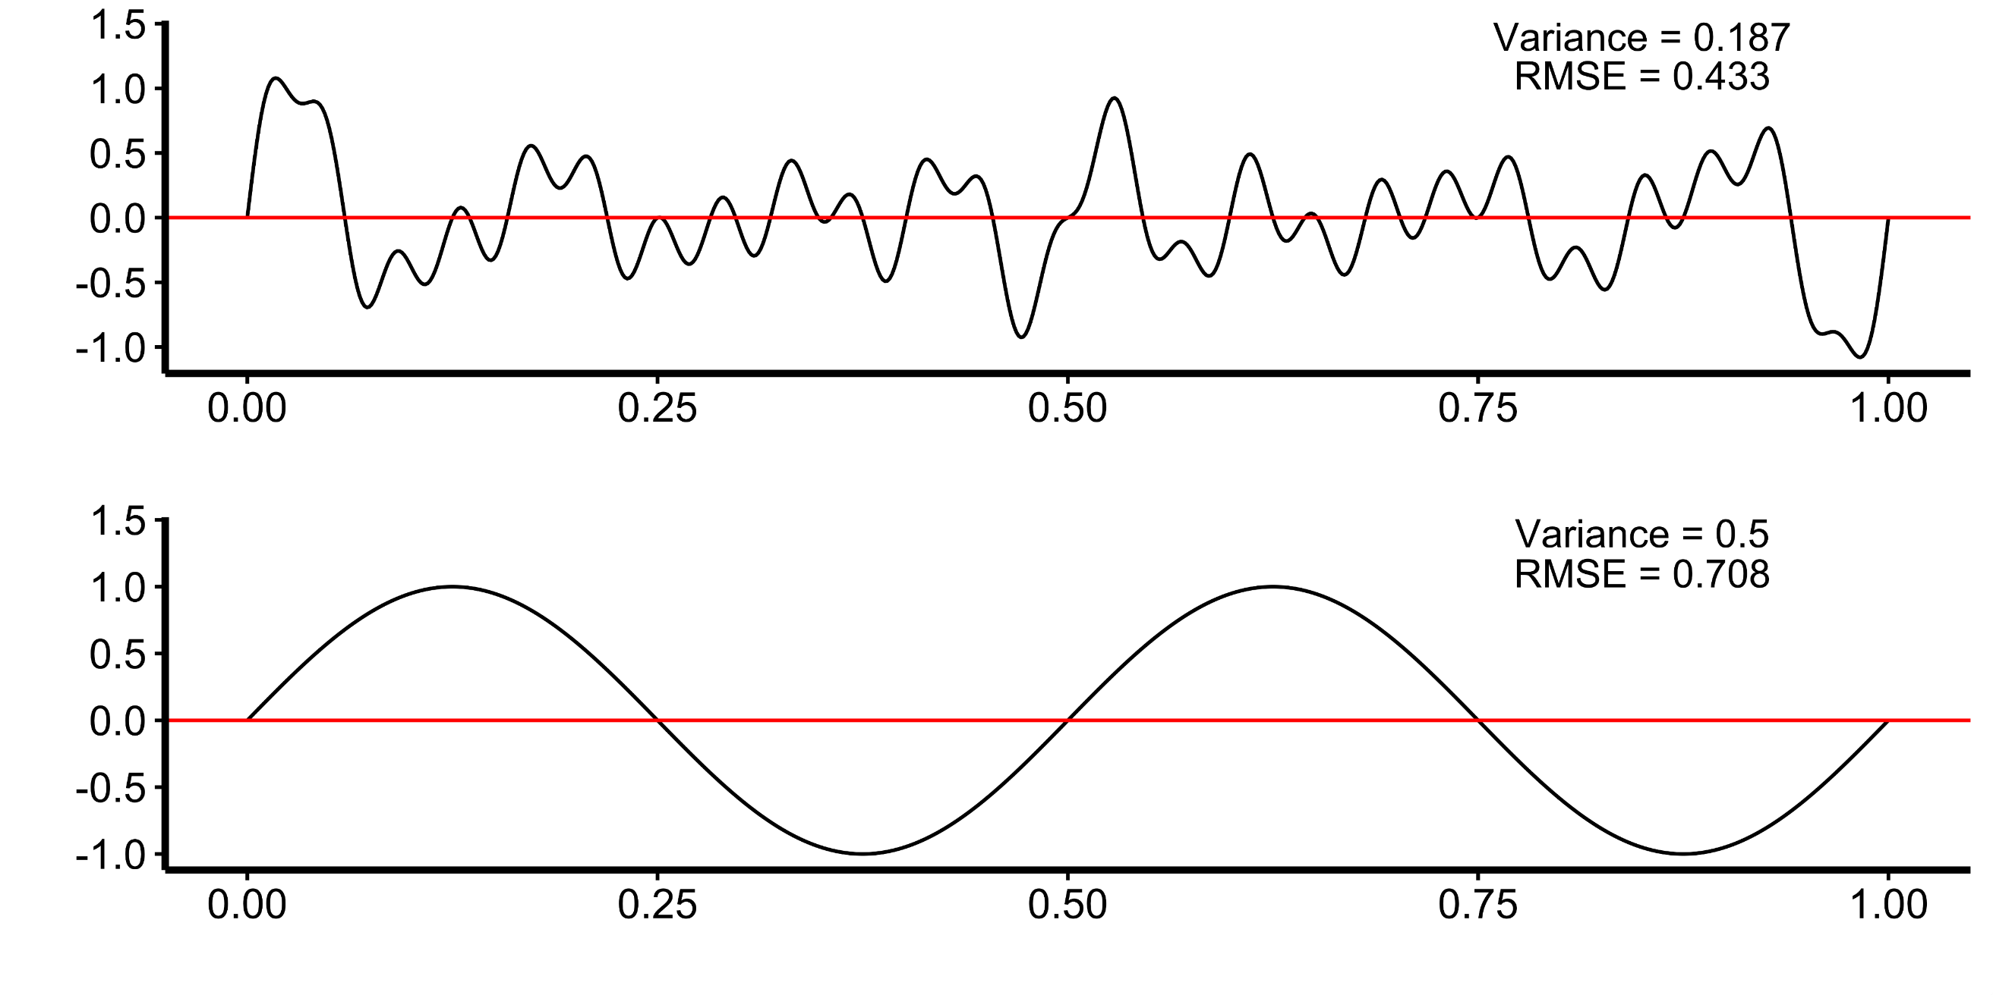
Notes:
Complexity, for our purposes, is defined as the presence of a spectrum of frequencies present in a signal. In the slide the sine wave on the bottom only oscillates at one frequency whereas the top is the same sine wife with the inclusion of other, faster frequencies. If we superimpose a line over the wave, we can see that the more complex signal minimizes the time spent away from the line. And so we can quantify the complexity of this wave form in several ways, and for purposes of this project, we are going to use entropy.
Importantly, complexity is hypothesized to reflect the interconnections between structural units necessary for creating the output.

Slide 12
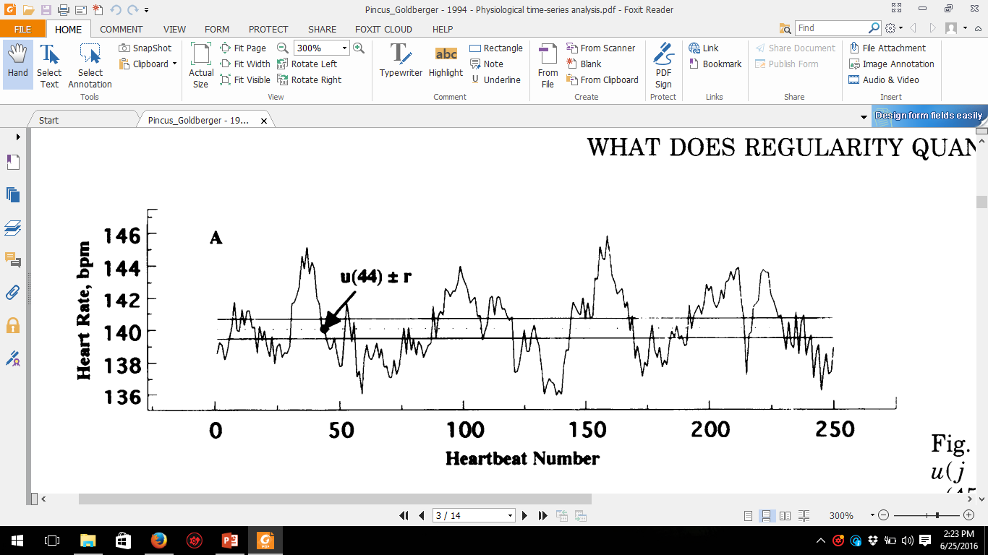
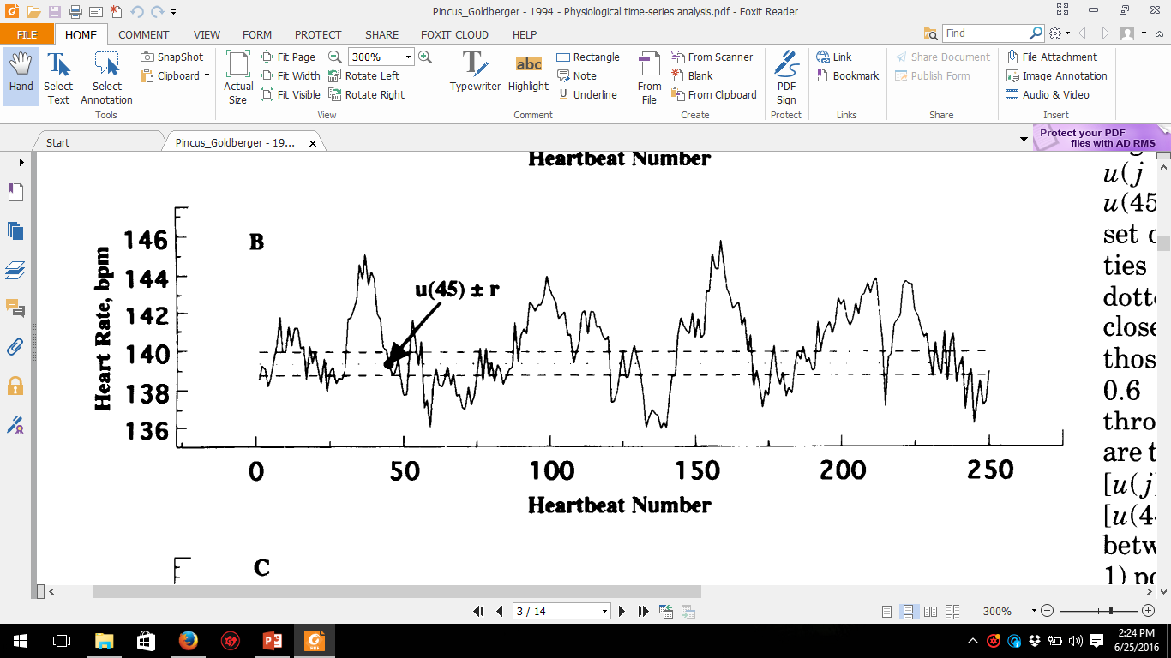
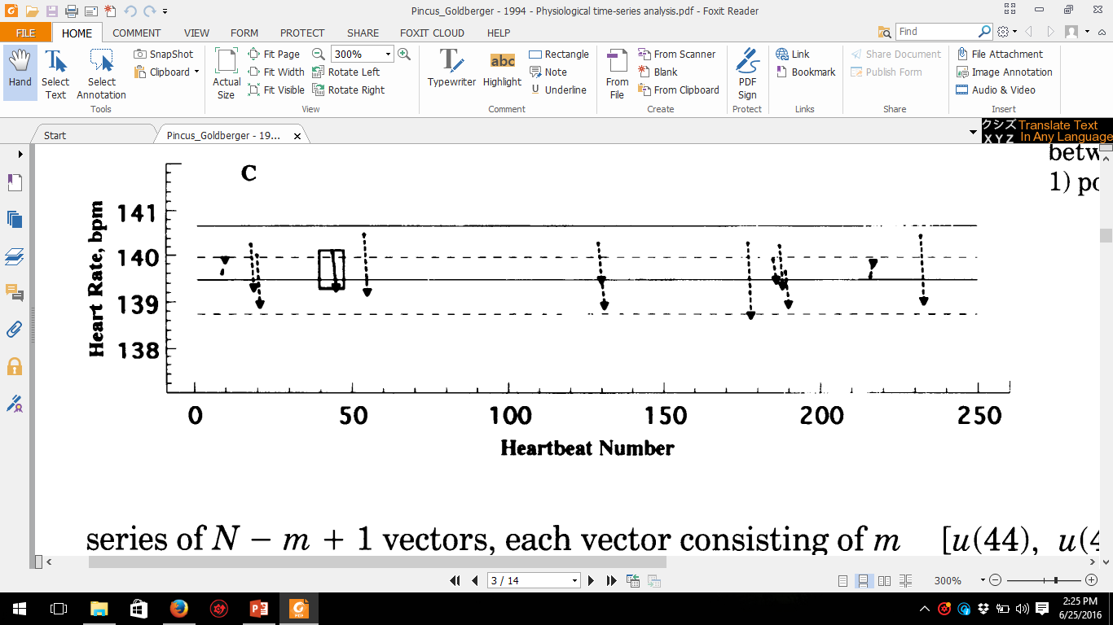
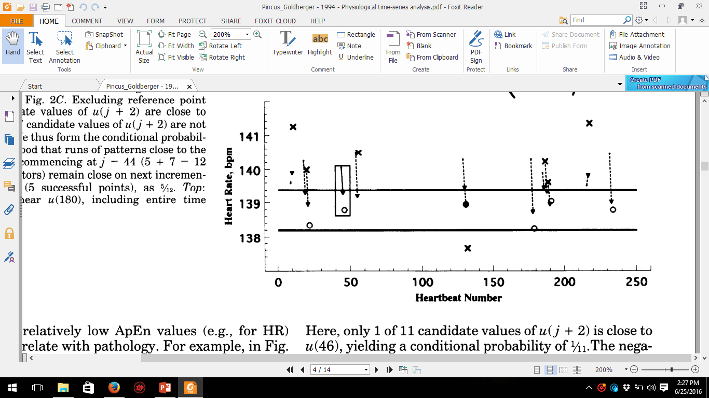
Pincus, 1994

Slide 13
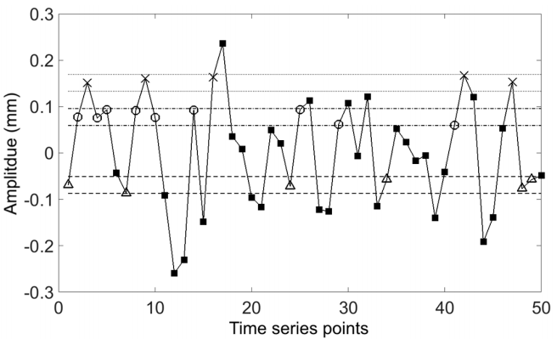
Gow, 2015

Slide 14
Sampling @ 100 Hz = 3 msec
Gow, 2015

Slide 15
60% of 20 Hz
30% of 10 Hz
3% of 1 Hz
1.5% of 0.5 Hz
Gow, 2015

Slide 16
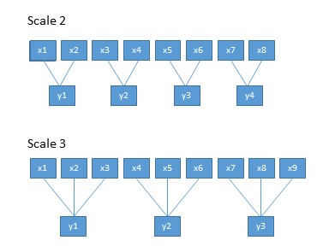
Adapted from Costa, 2002
Notes:
Course-graining procedure. Result for a scale factor is a downsampled signal

Slide 17
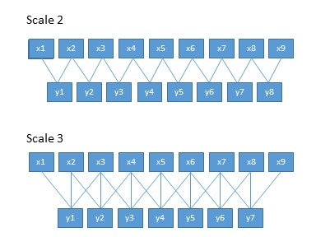
Adapted from Wu, 2013

Slide 18
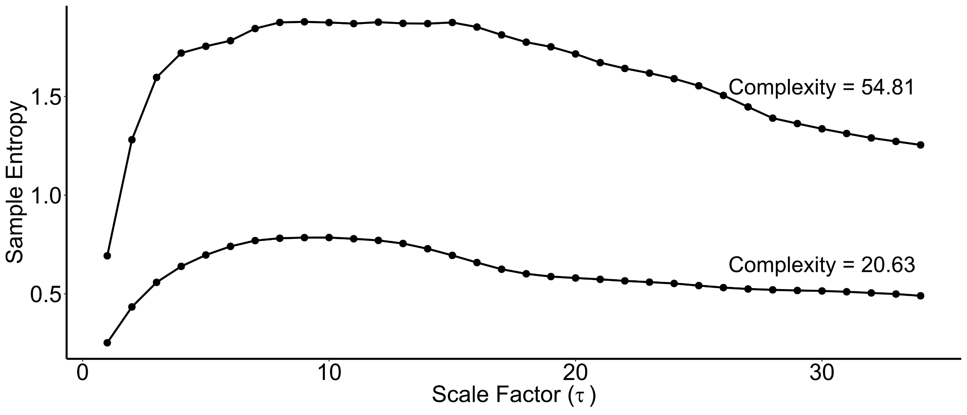

Slide 19
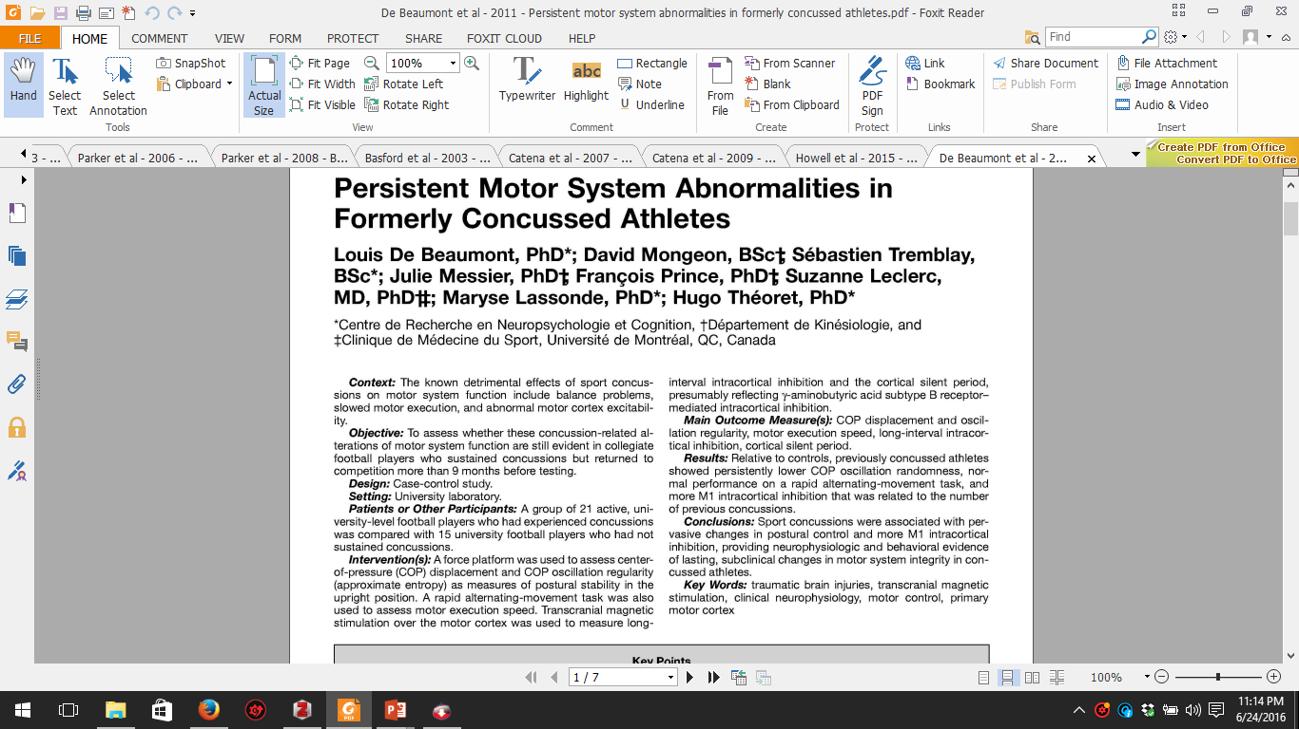
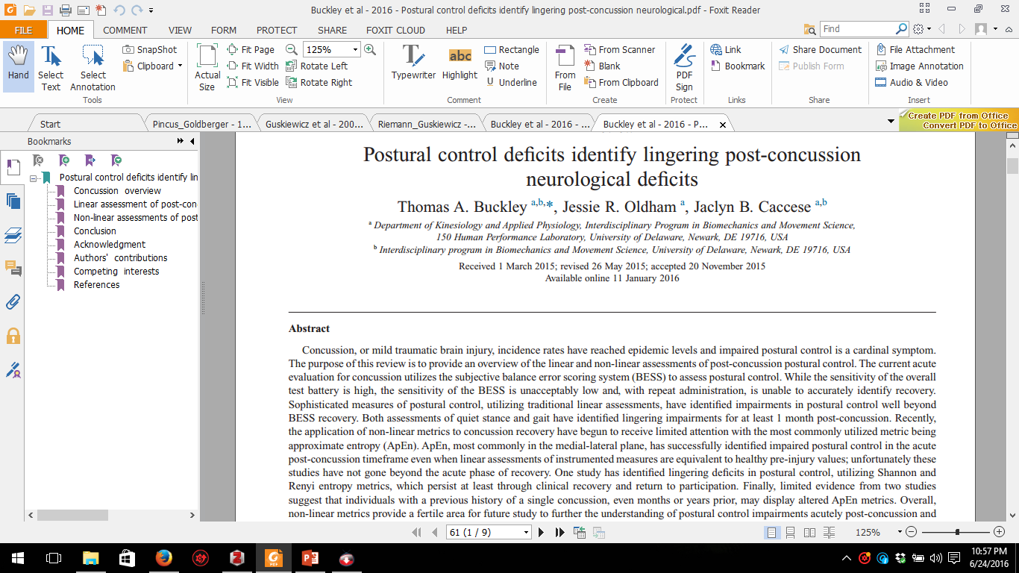
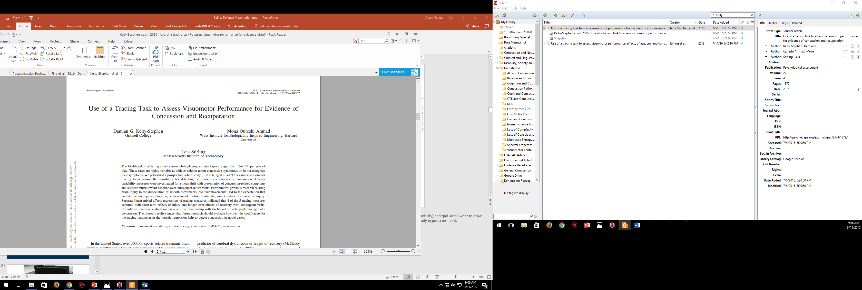
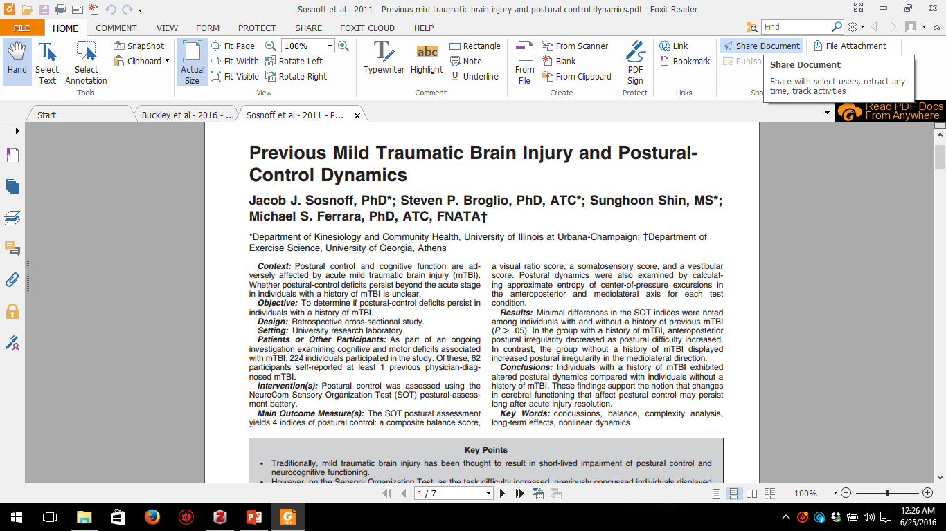
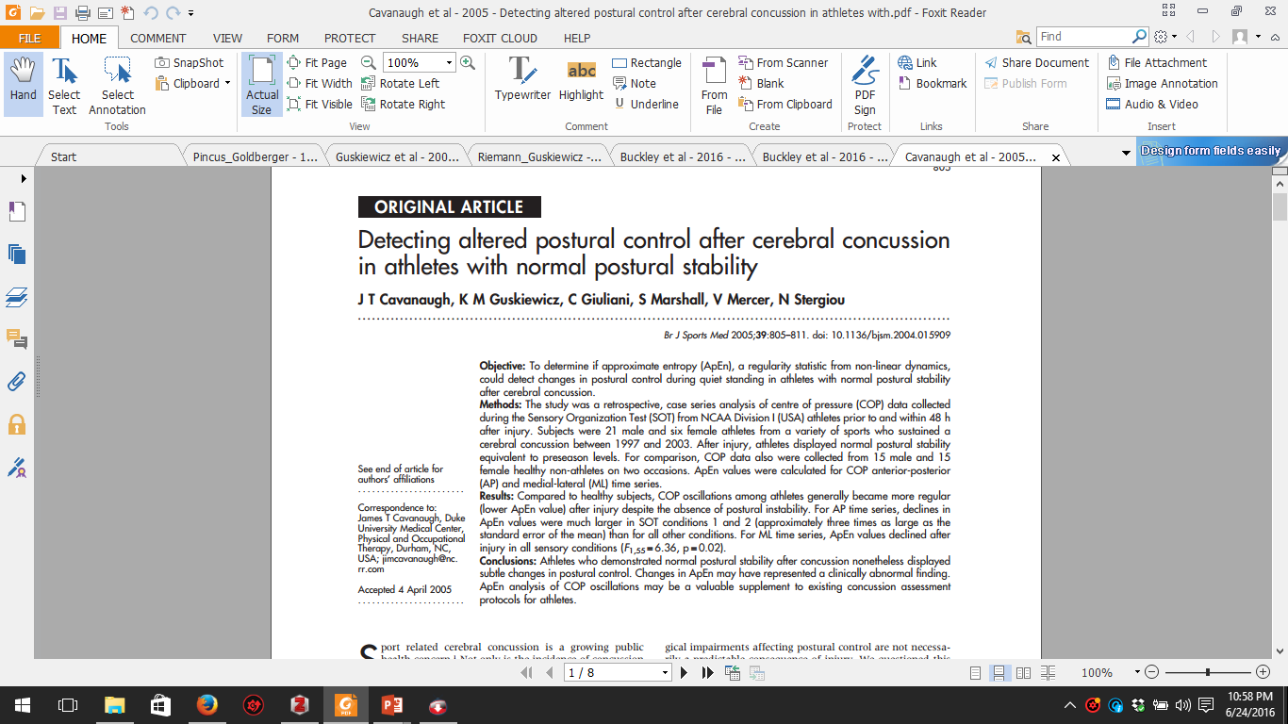
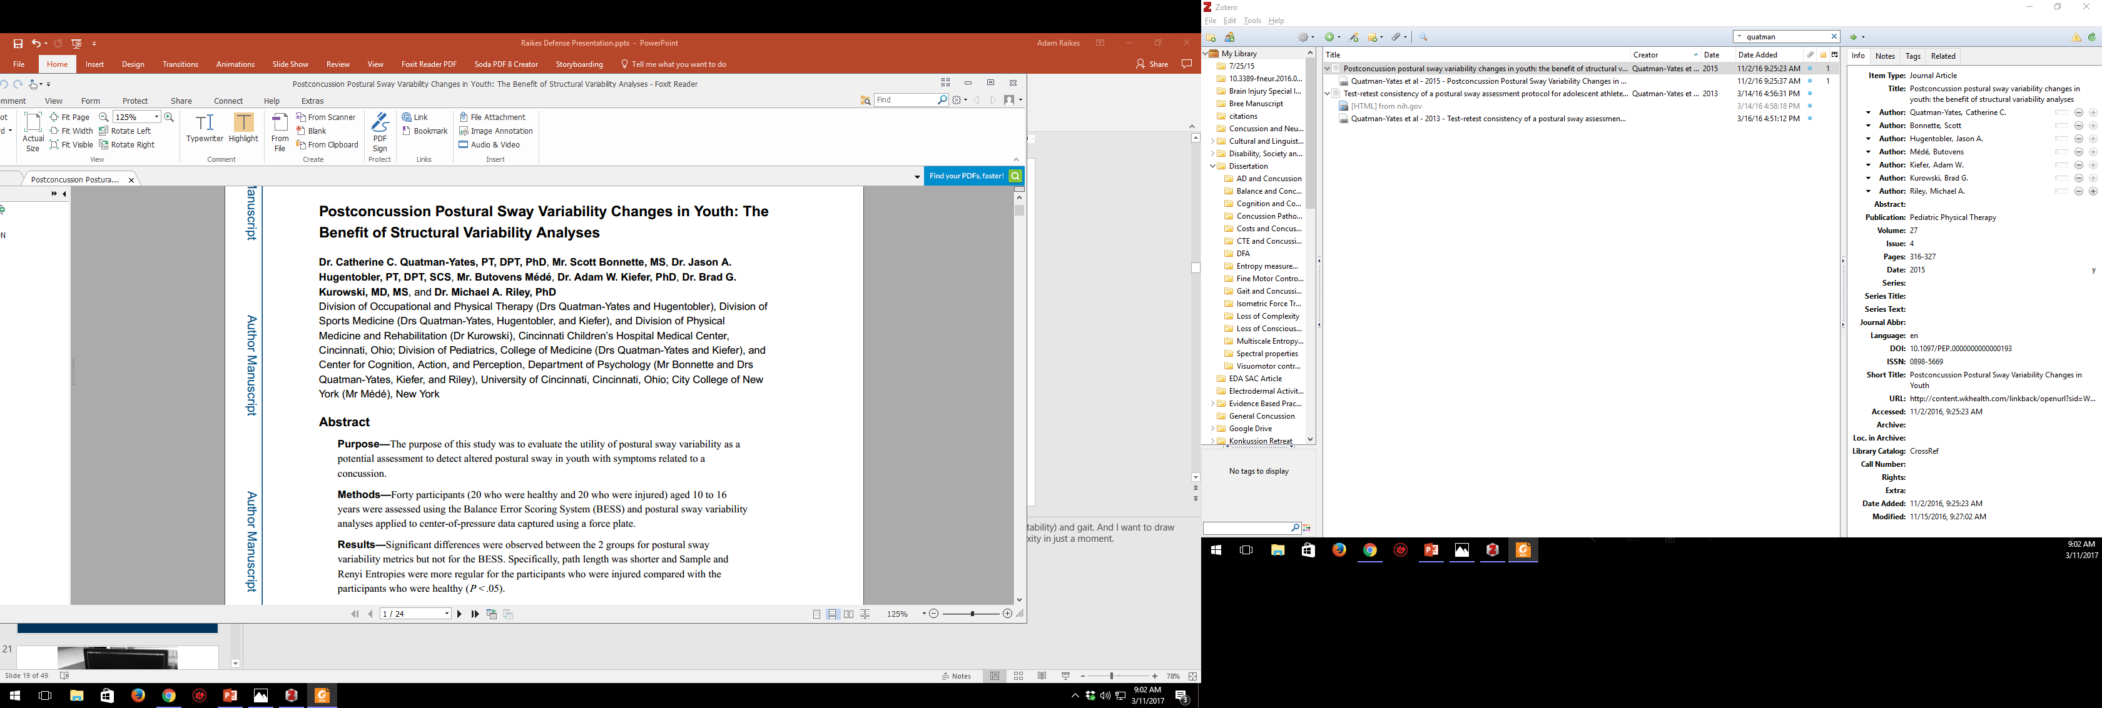
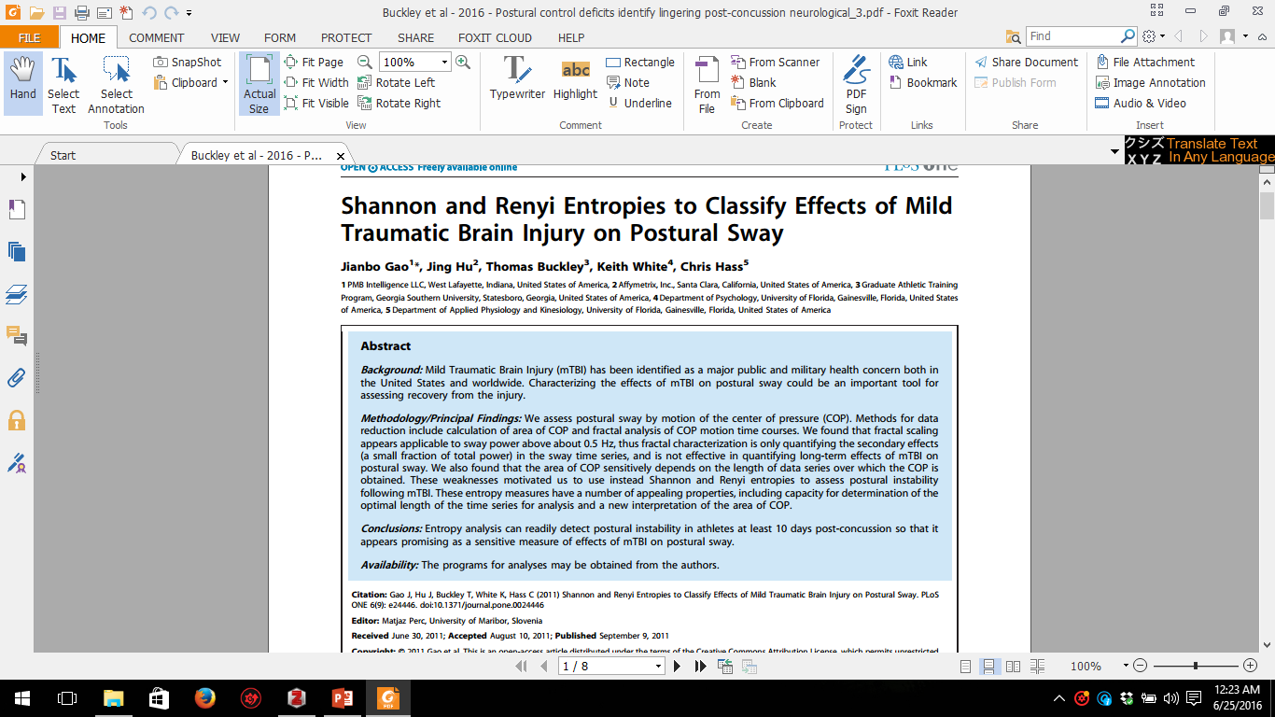
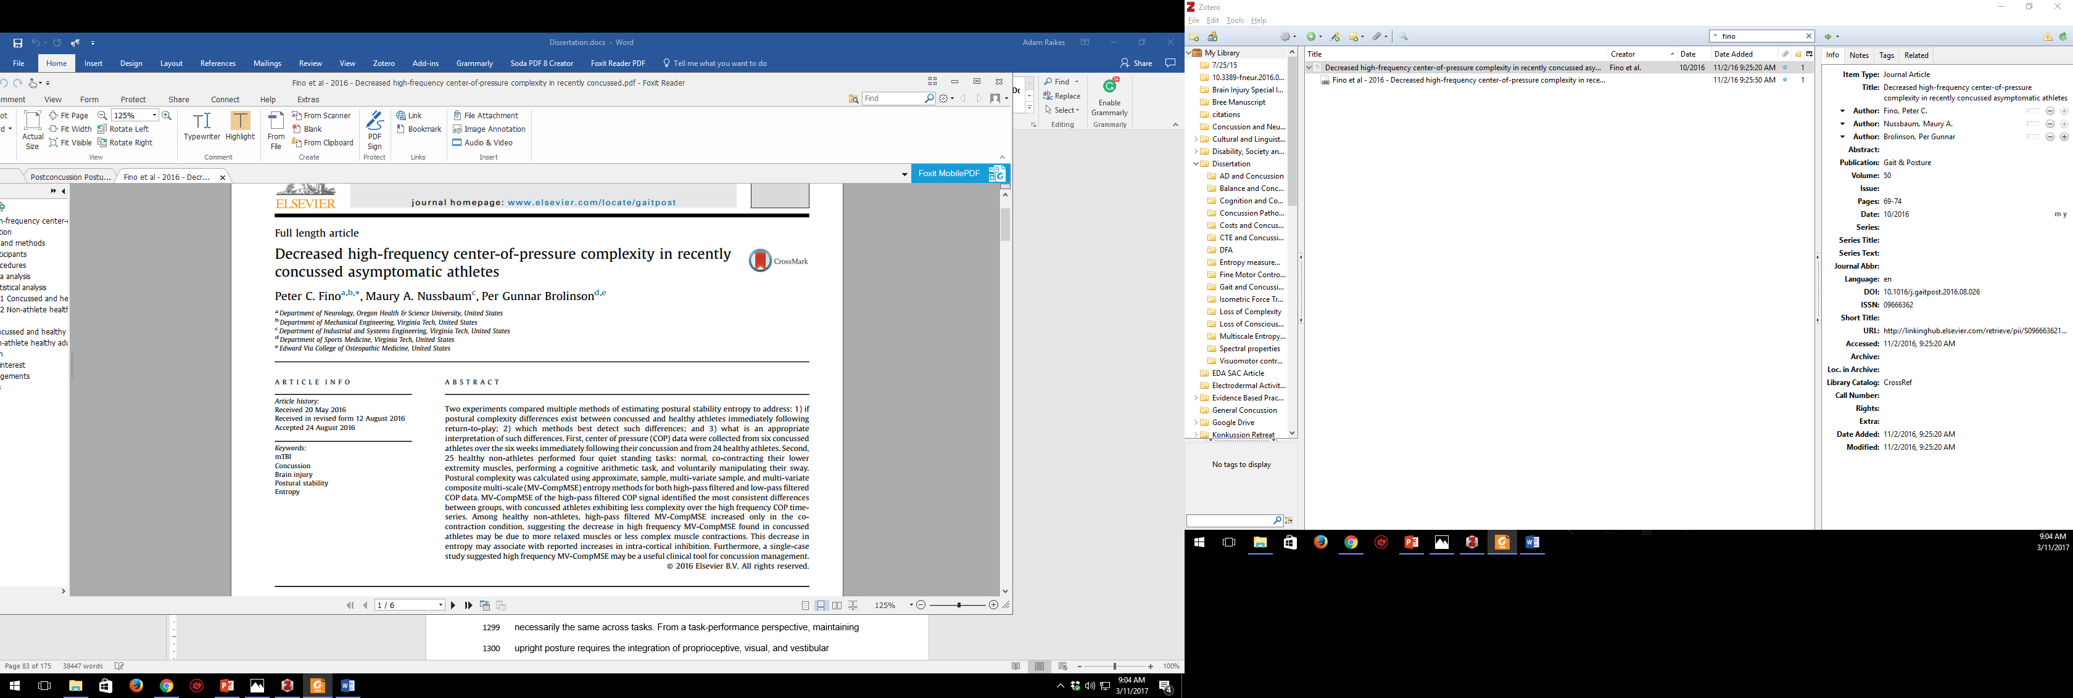
Notes:
(this is animated, nine clicks) we have a fairly large literature base to suggest that there are both immediate and long-term impairments in both balance (also referred to as postural control or stability) and gait. And I want to draw your attention just for a moment to the last three studies. In these studies, postural deficits (acute and lingering) were identified through the complexity of the sway. We’ll come back to complexity in just a moment.

Slide 20
Visual-Motor Tracking

Slide 21
Notes:
We can assess isometric force production and fine motor control with this. Participants press a force transducer and attempt to trace a straight line. While generally impossible, we are interested in the structure of the production. As the participant abducts against the FT, the white line goes up. As s/he adducts, (applies less force) it goes down. The goal is to minimize the error.

Slide 22
Memory Attention Executive Function Behavior Reaction Time Verbal Processing Visual Processing
Insomnia or hypersomnia
Trouble staying asleep
Poor sleep quality
Posture Gait Dexterity Motor Control

Slide 23
Statement of Purpose

Slide 24
To utilize a visual-motor tracking task to provide clinically-relevant information regarding
the extent to which concussion history and concussion symptoms influence task performance multiscale complexity and
whether task performance complexity can distinguish between individuals with and without a history of concussion.

Slide 25
Study #1 Hypotheses

Slide 26
Individuals with a history of concussion will have lower average complexity and greater trial to trial variability than individuals with no history.

Slide 27
Participants
Task
Outcomes
35 individuals with histories of diagnosed and/or suspected concussion
15 Healthy controls
No concussion hx
No history of neurologic or motor disease
Visual-motor tracking task
40% of MVC for 30 sec
10 trials
Root mean squared error
Complexity index*
Intra-individual variation (coefficient of variation)
Average spectral power (0-4 Hz, 4-8 Hz, 8-12 Hz)
Analysis
Individual multiple regressions
Predictors: Number of diagnosed and suspected concussions, prior history of concussion-related LOC and/or amnesia, gender*

Slide 28
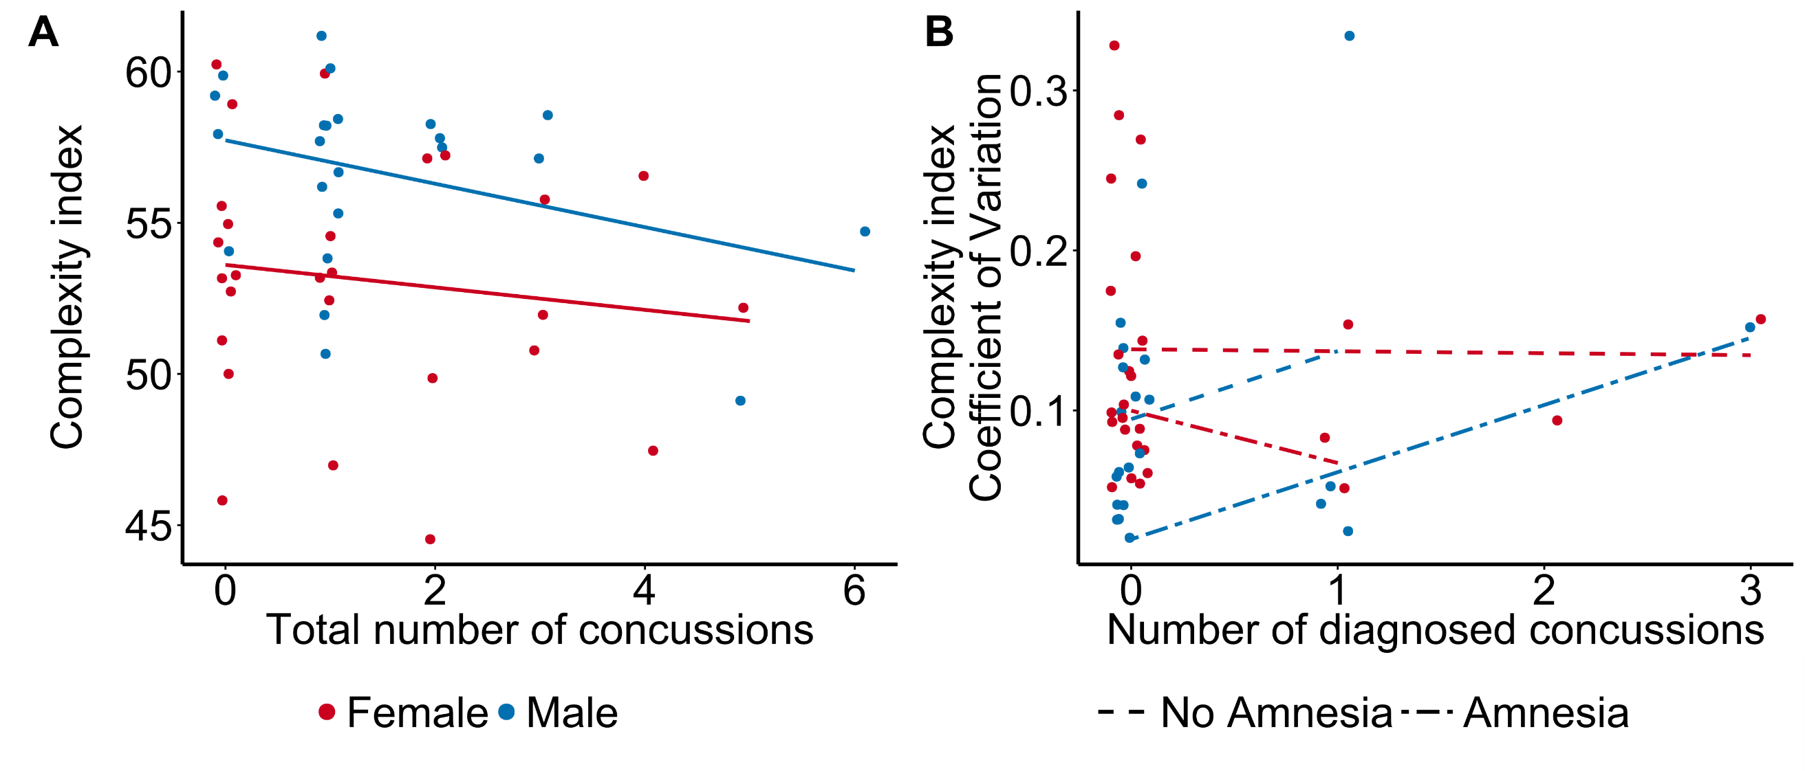

Slide 29
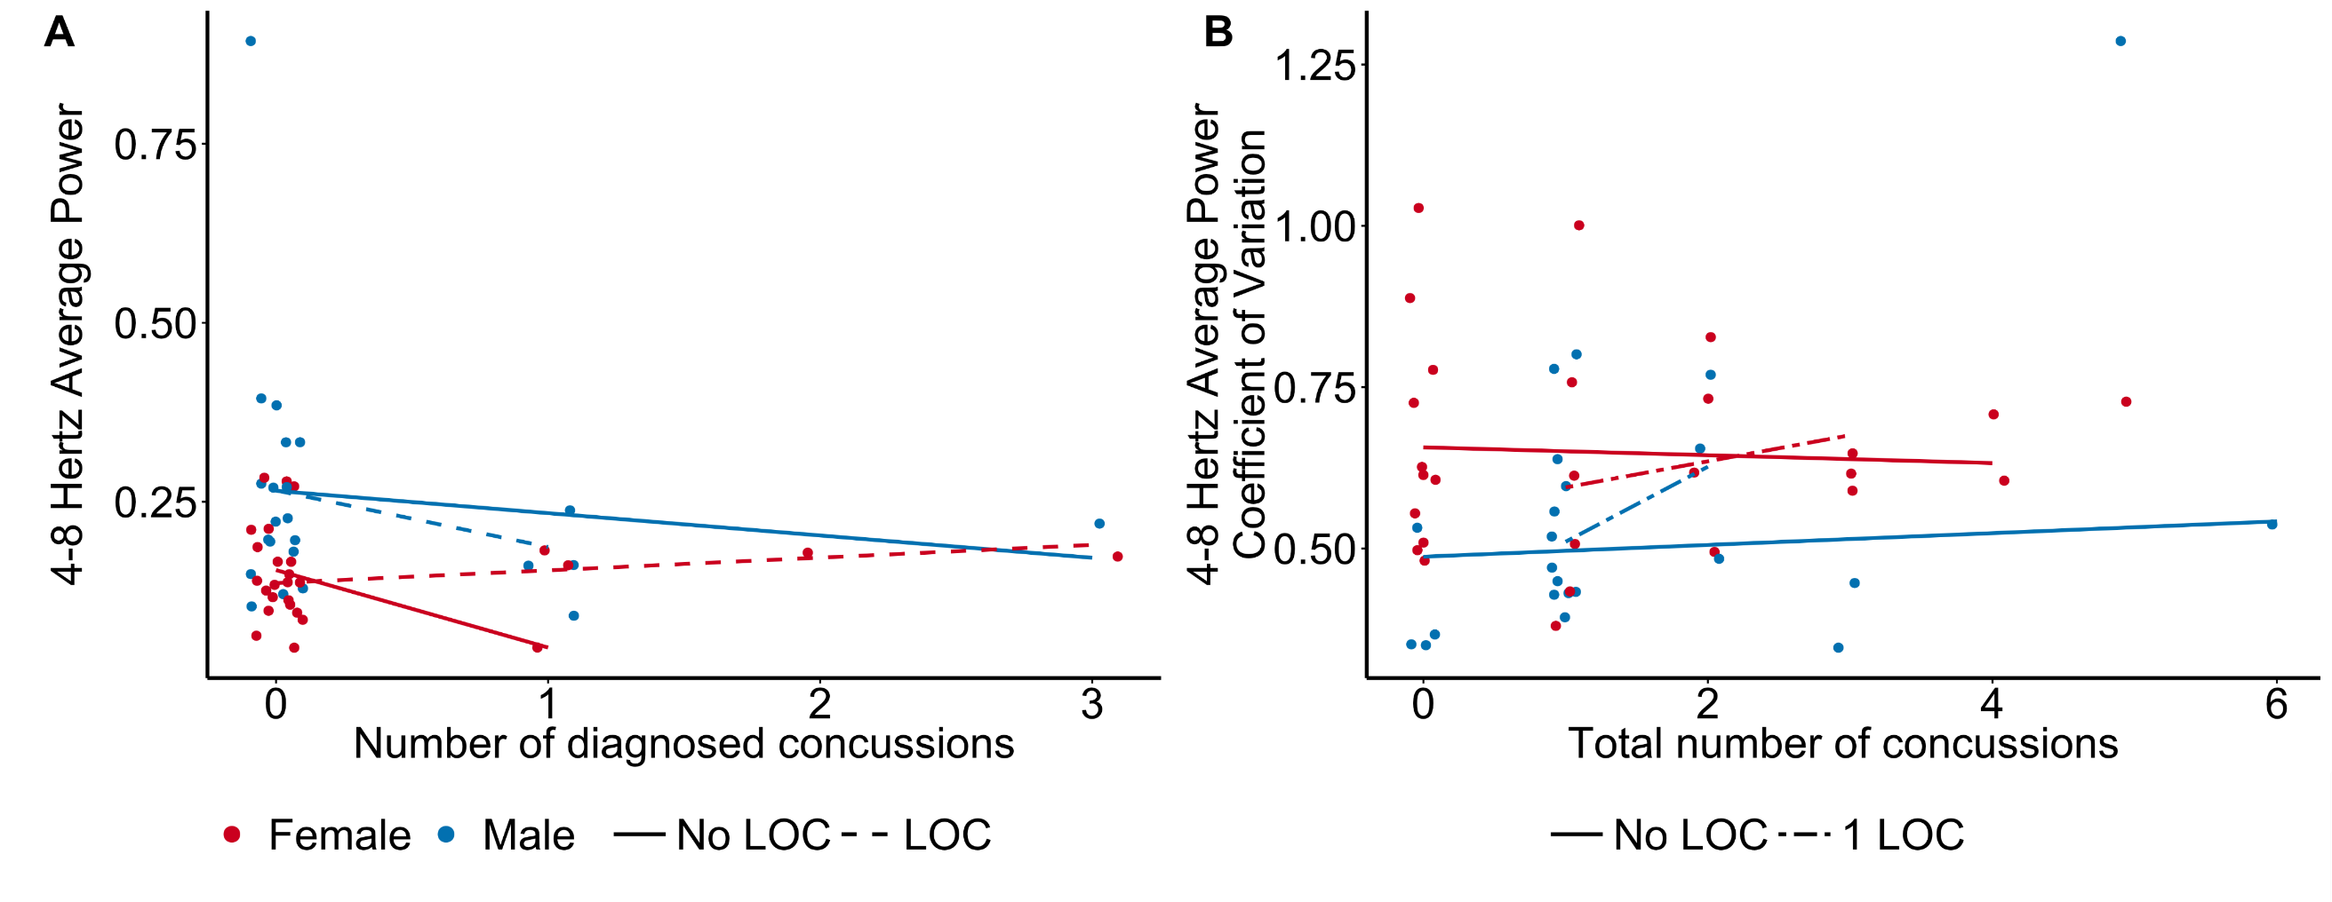

Slide 30
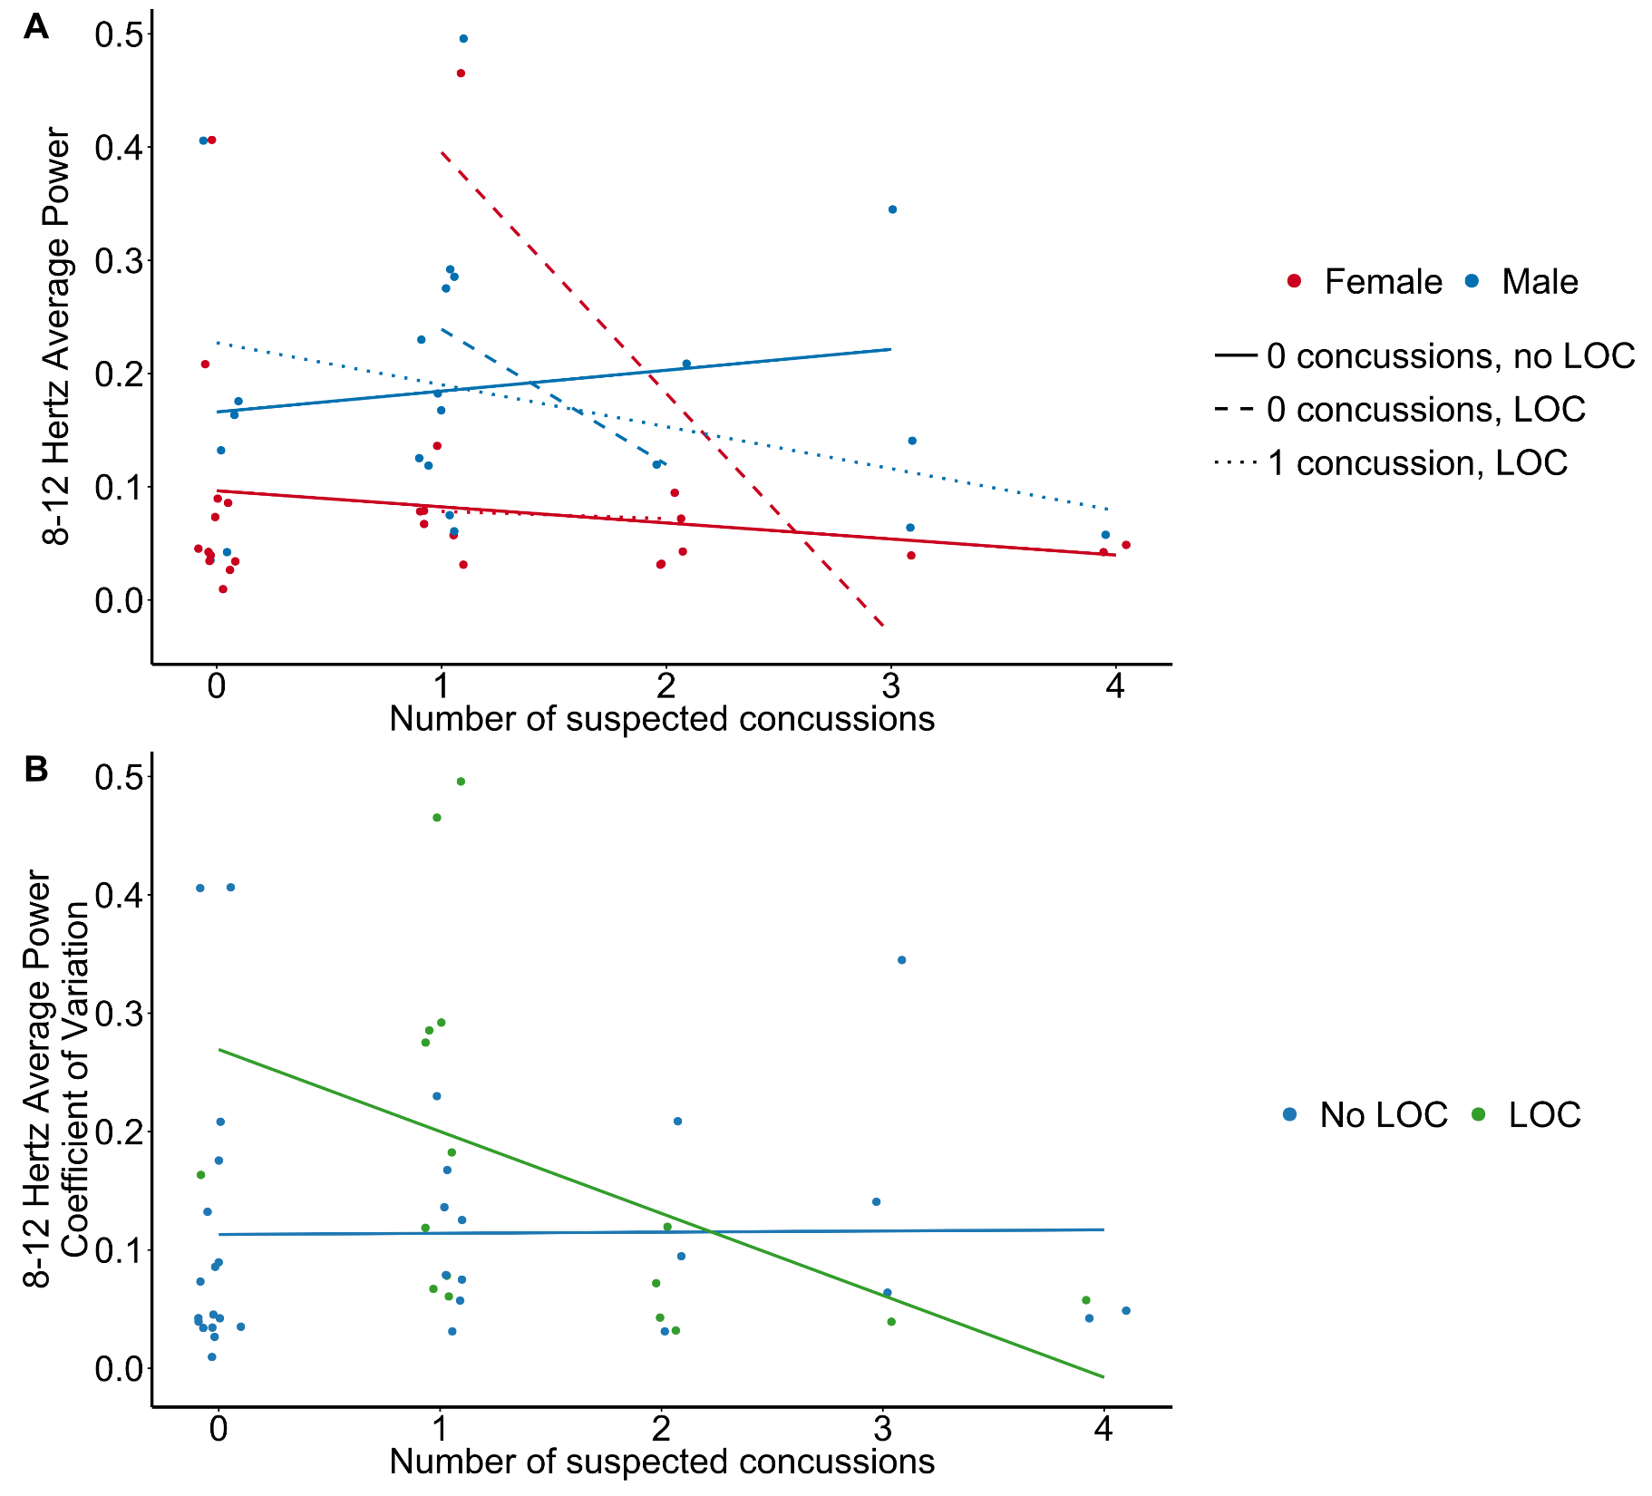

Slide 31
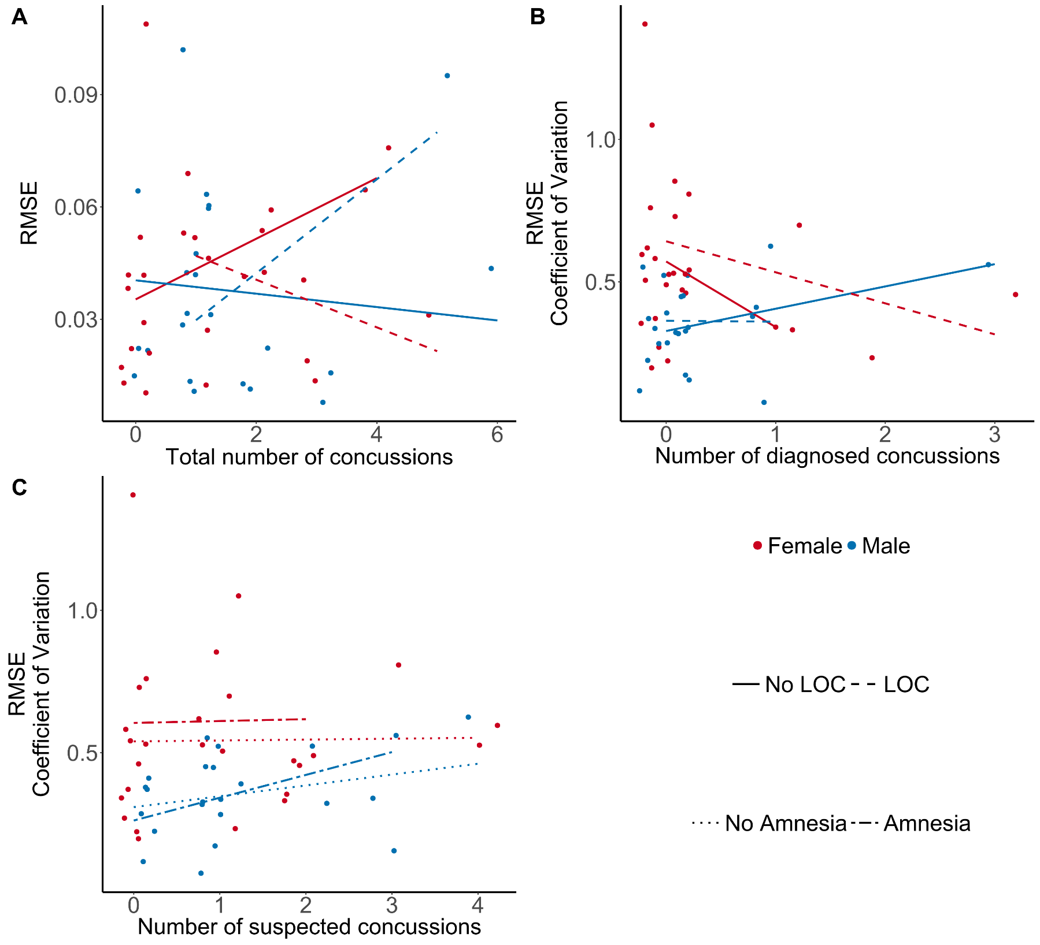

Slide 32
Study #1 Major Findings

Slide 33
Increasing numbers of concussions are associated with reduced task performance complexity, likely brought about by lower average power in mid-to-high frequency bands.
There are gender-specific differences in visual-motor tracking task performance and output complexity. These differences are additionally affected by histories of concussion-related loss of consciousness.
The present findings contribute to a larger body of work indicating that concussion results in increased intra-individual variability across multiple domains of cognitive, motor, and behavioral function. Not only should multiple-trial averages be considered in the evaluation of long-term concussion recovery, but intra-individual variability is an additionally important indicator of overall neurological health.
Notes:
Concurrent with the earlier definition of complexity (multiple frequencies, inter-connections between units), these findings indicate a general change in the way in which individuals utilize visual information to mitigate task-related error and may therefore indicate more widespread changes in visual-motor systems in general. This is supported by a recent fMRI study demonstrating that individuals with a history of concussion exhibit reduced functional connectivity in visual-attention networks and the cerebellum. One area of the VAN that is affected is the dorsolateral prefrontal cortex, which has also be implicated in changes to attention and spatial processing as well as persistent symptoms beyond the normal time course of recovery (post-concussion syndrome). Thus, nonlinear metrics like complexity may provide insight into VAN connectivity as well as DLPFC function without neuroimaging.
With respect to IIV, cognitive and motor performance variability increases with concussion, with areas of attention, spatial processing, and the DLPFC being implicated.

Slide 34
Study #2 Purpose

Slide 35
To determine whether various measures of nonlinear regularity and complexity accurately discriminate between individuals with and without a history of concussion

Slide 36
Participants
Task
Outcomes
85 individuals with histories of diagnosed or suspected concussion
42 Healthy controls
No concussion hx
No history of neurologic or motor disease
Visual-motor tracking task
40% of MVC for 30 sec
10 trials
Root mean squared error
Complexity index*
Detrended fluctuation α
Average spectral power (0-4 Hz, 4-8 Hz, 8-12 Hz)
Analysis
10-fold cross-validated logistic regression
Receiver operating characteristic curve sensitivity, specificity, positive and negative predictive value, and area under the curve (AUC)

Slide 38
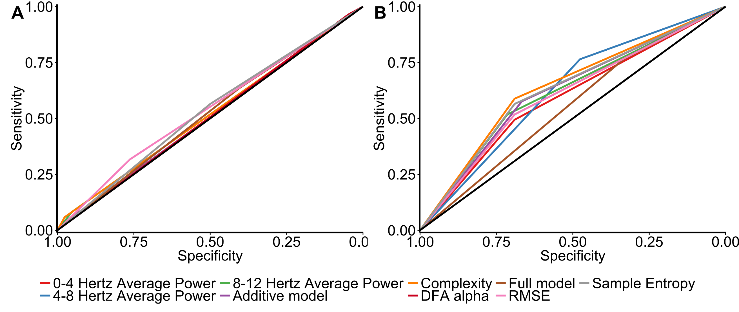
Areas under the curve for a priori (A) and gender-stratified (B) models

Slide 39
Table 4‑4 Sensitivity, specificity, and predictive values for linear and nonlinear metrics
Predictor | Sens. (%) | Spec. (%) | PPV (%) | NPV (%) | Acc. (%)
DFA α | 96.47 | 4.76 | 67.21 | 40.00 | 66.14
Complexity | 5.88 | 97.61 | 83.33 | 33.88 | 36.22
Sample Entropy | 56.47 | 50.00 | 69.57 | 36.21 | 54.33
0-4 Hertz Average Power | 100.00 | 0.00 | 66.93 | - | 66.93
4-8 Hertz Average Power | 8.24 | 92.86 | 70.00 | 33.33 | 36.22
8-12 Hertz Average Power | 8.24 | 95.24 | 77.78 | 33.90 | 37.01
RMSE | 31.75 | 76.19 | 72.97 | 35.56 | 46.46
Additive model | 5.88 | 95.24 | 71.43 | 33.33 | 35.43
Note: Sens. = sensitivity; Spec. = specificity; PPV = positive predictive value; NPV = negative predictive value; Acc. = accuracy; DFA = detrended fluctuation analysis; RMSE = root mean squared error; The additive model included DFA α and complexity as predictors.

Slide 40
Table 4‑5 Sensitivity, specificity, and predictive values for models including gender and linear and nonlinear metrics
Predictor | Sens. (%) | Spec. (%) | PPV (%) | NPV (%) | Acc. (%)
DFA α | 51.76 | 69.05 | 77.19 | 41.43 | 57.48
Complexity | 58.82 | 69.05 | 79.37 | 45.31 | 62.20
Sample Entropy | 56.47 | 69.05 | 78.69 | 43.94 | 60.63
0-4 Hertz Average Power | 49.41 | 69.05 | 76.36 | 40.28 | 55.91
4-8 Hertz Average Power | 76.47 | 47.62 | 74.71 | 50.00 | 66.93
8-12 Hertz Average Power | 51.76 | 71.43 | 78.57 | 42.25 | 58.27
RMSE | 51.76 | 69.05 | 77.19 | 41.43 | 57.48
Additive model | 57.65 | 66.67 | 77.78 | 43.75 | 60.63
Note: Sens. = sensitivity; Spec. = specificity; PPV = positive predictive value; NPV = negative predictive value; Acc. = accuracy; DFA = detrended fluctuation analysis; RMSE = root mean squared error; The additive model included DFA α and complexity as predictors.

Slide 41
Table 4‑6 Specificity and predictive values for models including gender and linear and nonlinear metrics at 80% sensitivity
Predictor | Spec. (%) | PPV (%) | NPV (%) | Acc. (%)
DFA α | 38.10 | 72.34 | 48.48 | 66.14
Complexity | 33.33 | 70.83 | 45.16 | 64.57
Sample Entropy | 33.33 | 71.13 | 46.67 | 65.35
0-4 Hertz Average Power | 16.67 | 66.67 | 31.82 | 60.63
4-8 Hertz Average Power | 42.86 | 74.19 | 52.94 | 68.50
8-12 Hertz Average Power | 26.19 | 69.00 | 40.74 | 62.99
RMSE | 28.57 | 69.70 | 42.86 | 63.78
Additive model | 35.71 | 71.58 | 46.88 | 65.35
Note: Sens. = sensitivity; Spec. = specificity; PPV = positive predictive value; NPV = negative predictive value; Acc. = accuracy; DFA = detrended fluctuation analysis; RMSE = root mean squared error; The additive model included DFA α and complexity as predictors.

Slide 42
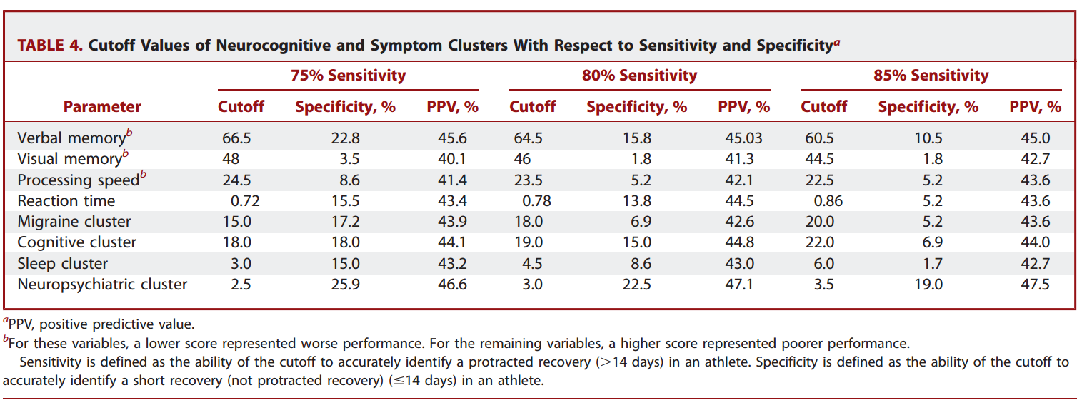
Lau, Collins, & Lovell, 2012

Slide 43
Study #2 Major Findings

Slide 44
Gender-specific predictive models provide better predictive capacity than models considering only visual-motor tracking task output characteristics.
Approximately 75% of the individuals predicted to have a history of concussion did indeed have such a history.
Such discrimination has clinical value in identifying individuals who merit further evaluation and observation over time for conditions related to repetitive head traumas, including ALS, Parkinson’s disease, and chronic traumatic encephalopathy.

Slide 45
REFERENCES
Buckley, T. A., Munkasy, B. A., Tapia-Lovler, T. G., & Wikstrom, E. A. (2013). Altered gait termination strategies following a concussion. Gait & Posture, 38(3), 549–551.
Buckley, T. A., Oldham, J. R., & Caccese, J. B. (2016). Postural control deficits identify lingering post-concussion neurological deficits. Journal of Sport and Health Science, 5(1), 61–69. http://doi.org/10.1016/j.jshs.2016.01.007
Catena, R. D., van Donkelaar, P., & Chou, L.-S. (2007). Altered balance control following concussion is better detected with an attention test during gait. Gait & Posture, 25(3), 406–411.
Cavanaugh, J. T., Guskiewicz, K. M., Giuliani, C., Marshall, S., Mercer, V. S., & Stergiou, N. (2005). Detecting altered postural control after cerebral concussion in athletes with normal postural stability. British Journal of Sports Medicine, 39(11), 805–811. http://doi.org/10.1136/bjsm.2004.015909
Cavanaugh, J. T., Guskiewicz, K. M., Giuliani, C., Marshall, S., Mercer, V. S., & Stergiou, N. (2006). Recovery of postural control after cerebral concussion: New insights using approximate entropy. Journal of Athletic Training, 41(3), 305–313.
Costa, M., Goldberger, A. L., & Peng, C.-K. (2002). Multiscale entropy analysis of complex physiologic time series. Physical Review Letters, 89(6), 68102.
Daneshvar, D. H., Nowinski, C. J., McKee, A. C., & Cantu, R. C. (2011). The epidemiology of sport-related concussion. Clinics in Sports Medicine, 30(1), 1–17. http://doi.org/10.1016/j.csm.2010.08.006
De Beaumont, L., Mongeon, D., Tremblay, S., Messier, J., Prince, F., Leclerc, S., … Théoret, H. (2011). Persistent motor system abnormalities in formerly concussed athletes. Journal of Athletic Training, 46(3), 234–240.
Finkelstein, E. A., Corso, P. S., & Miller, T. R. (2006). Incidence and economic burden of injuries in the United States. Oxford University Press.
Gao, J., Hu, J., Buckley, T., White, K., & Hass, C. (2011). Shannon and Renyi Entropies to Classify Effects of Mild Traumatic Brain Injury on Postural Sway. PLoS ONE, 6(9), e24446. http://doi.org/10.1371/journal.pone.0024446
Gow, B., Peng, C.-K., Wayne, P., & Ahn, A. (2015). Multiscale Entropy Analysis of Center-of-Pressure Dynamics in Human Postural Control: Methodological Considerations. Entropy, 17(12), 7926–7947. http://doi.org/10.3390/e17127849

Slide 46
Guskiewicz, K. M., Ross, S. E., & Marshall, S. W. (2001). Postural stability and neuropsychological deficits after concussion in collegiate athletes. Journal of Athletic Training, 36(3), 263–273.
Howell, D. R., Osternig, L. R., & Chou, L.-S. (2015). Return to activity after concussion affects dual-task gait balance control recovery. Medicine And Science In Sports And Exercise, 47(4), 673–80.
Langlois, J. A., Rutland-Brown, W., & Wald, M. M. (2006). The epidemiology and impact of traumatic brain injury: a brief overview. The Journal of Head Trauma Rehabilitation, 21(5), 375–378.
Lau, B. C., Collins, M. W., & Lovell, M. R. (2012). Cutoff scores in neurocognitive testing and symptom clusters that predict protracted recovery from concussions in high school athletes. Neurosurgery, 70(2), 371–379. https://doi.org/10.1227/NEU.0b013e31823150f0
Liao, F., Wang, J., & He, P. (2008). Multi-resolution entropy analysis of gait symmetry in neurological degenerative diseases and amyotrophic lateral sclerosis. Medical Engineering & Physics, 30(3), 299–310.
McCrea, M., Guskiewicz, K. M., Marshall, S. W., Barr, W. B., Randolph, C., Cantu, R. C., … Kelly, J. P. (2003). Acute effects and recovery time following concussion in collegiate football players: The NCAA Concussion Study. The Journal of the American Medical Association, 290(19), 2556–2563.
McCrea, M., Kelly, J. P., Randolph, C., Kluge, J., Bartolic, E., Finn, G., & Baxter, B. (1998). Standardized Assessment of Concussion (SAC): on-site mental status evaluation of the athlete. The Journal of Head Trauma Rehabilitation, 13(2), 27–35.
McCrory, P., Meeuwisse, W. H., Aubry, M., Cantu, R. C., Dvořák, J., Echemendia, R. J., … McCrea, M. (2013). Consensus statement on concussion in sport: The 4th International Conference on Concussion in Sport held in Zurich, November 2012. British Journal of Sports Medicine, 47(5), 1–12. http://doi.org/10.1136/bjsports-2013-092313
National Center for Injury Prevention (US). (2003). Report to Congress on mild traumatic brain injury in the United States: Steps to prevent a serious public health problem. Centers for Disease Control and Prevention.
Newell, K. M., Vaillancourt, D. E., & Sosnoff, J. J. (2006). Aging, complexity, and motor performance. Handbook of the Psychology of Aging, 163–182.
Pincus, S. M., & Goldberger, A. L. (1994). Physiological time-series analysis: what does regularity quantify? American Journal of Physiology - Heart and Circulatory Physiology, 266(4), H1643–H1656.

Slide 47
Riemann, B. L., & Guskiewicz, K. M. (2000). Effects of mild head injury on postural stability as measured through clinical balance testing. Journal of Athletic Training, 35(1), 19–25.
Slobounov, S. M., Sebastianelli, W., & Simon, R. (2002). Neurophysiological and behavioral concomitants of mild brain injury in collegiate athletes. Clinical Neurophysiology, 113(2), 185–193. http://doi.org/10.1016/S1388-2457(01)00737-4
Sosnoff, J. J., Broglio, S. P., Shin, S., & Ferrara, M. S. (2011). Previous mild traumatic brain injury and postural-control dynamics. Journal of Athletic Training, 46(1), 85–91.
Ünlü, A., Brause, R., & Krakow, K. (2006). Handwriting analysis for diagnosis and prognosis of Parkinson’s disease. In Biological and Medical Data Analysis (pp. 441–450). Springer Berlin Heidelberg.
Vaillancourt, D. E., & Newell, K. M. (2000). The dynamics of resting and postural tremor in Parkinson’s disease. Clinical Neurophysiology, 111(11), 2046–2056.
Vaillancourt, D. E., Slifkin, A. B., & Newell, K. M. (2001). Intermittency in the visual control of force in Parkinson’s disease. Experimental Brain Research, 138(1), 118–127. http://doi.org/10.1007/s002210100699
Vaillancourt, D. E., Sosnoff, J. J., & Newell, K. M. (2004). Age-related changes in complexity depend on task dynamics. Journal of Applied Physiology, 97(1), 454–455. http://doi.org/10.1152/japplphysiol.00244.2004
Wu, S.-D., Wu, C.-W., Lee, K.-Y., & Lin, S.-G. (2013). Modified multiscale entropy for short-term time series analysis. Physica A, 392(23), 5865–5873. http://doi.org/10.1016/j.physa.2013.07.075

Slide 48
Adam Raikes, MS, LAT, ATC Department of Kinesiology and Health Science

Slide 49
Extras

Slide 50
